Slide 1
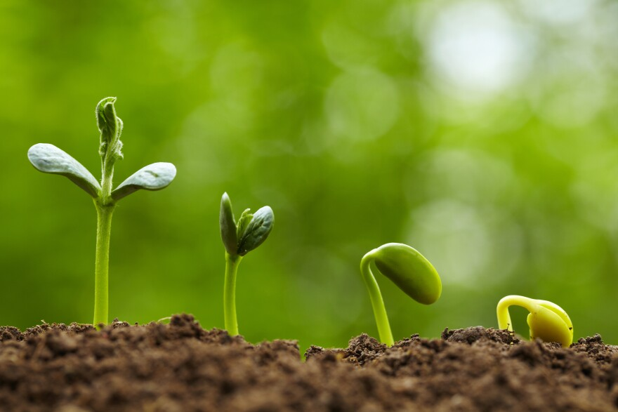


Cultivating Sustainability to Grow Sustainable Communities
Notes:
SeedHUB, logo, Punchline
Logo sdgs

Slide 2

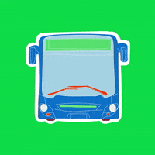

What is a sustainable city?
Green Public Transportation
Energy Efficient Buildings
Comfort and Security in the city

Slide 3

PEOPLE !!

Slide 4
We have to educate them!
Look if there is a car before crossing the street
Use the bathroom

Slide 5

Sustainable Hubs !

Slide 6







































Notes:
Broad concept of the hub
The logo
Lot of leaves, each leaf one Thing
Seed is the learning hub

Slide 7













Community
Farming
Workshops
Notes:
Broad concept of the hub
The logo
Lot of leaves, each leaf one Thing
Seed is the learning hub

Slide 8



